Slide 1
FileIO

Slide 2

What is FileIO?
File In-Out
How do we read actual data on disc as opposed to creating and manipulating data in memory.

Slide 3
Why do we use it?
It is nice to save data sometimes
We might have data that we need to parse that came in a file
Makes learning programming so much more interesting
Especially the advanced stuff
Parsing data is useful in countless situations
This is a great way to practice parsing data

Slide 4
Warning
The most common error that you will encounter says that…
“The type or namespace could not be found……….”
using System.IO;

Slide 5
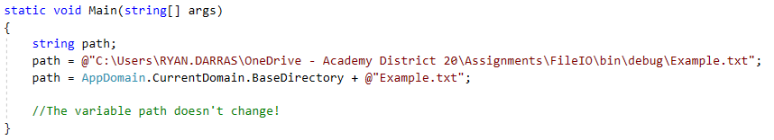
Hard coding paths is bad!
When someone else tries to use your code, it won’t work because they won’t have an identical path signature.
DON’T HARDCODE PATHS!!!
It won’t run on my machine because I have different paths than you!

Slide 6
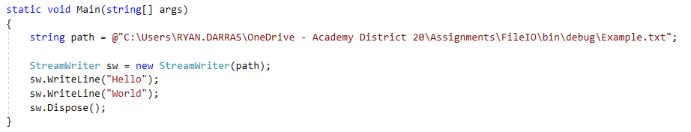
StreamWriter
The ‘@’ in the string makes the compiler ignore all ‘\’ characters.
‘\’ is the escape character.

Slide 7
The “using” keyword
Not to be confused with the “using” keyword at the top of our files to include other libraries. This is the same word but different use.
Any class that implements the IDisposable interface can be thrown into a using statement.
StreamWriter and StreamReader implement IDisposable, so we can use the using keyword to automatically dispose of the file.
More organized, and much safer.

Slide 8
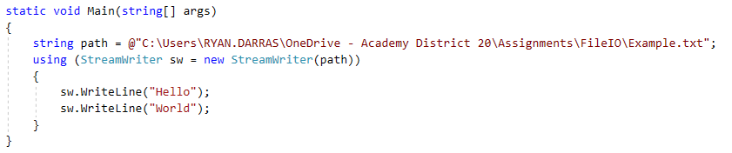
Example
We will ALWAYS use the using keyword instead of manually disposing the stream.

Slide 9
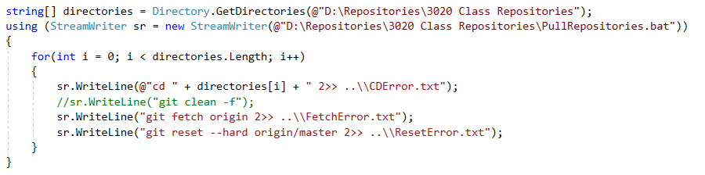
StreamWriter (The O in FileIO)

Slide 10
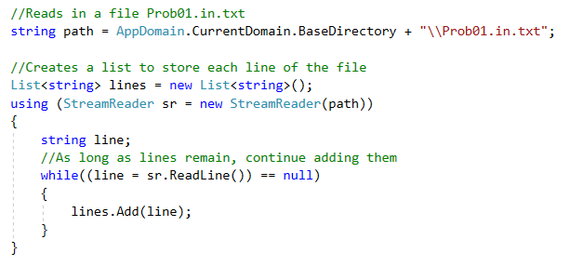
StreamReader (The I in FileIO)
Sr.ReadLine() reads the next line in the file, but how do we know how many lines in the file? How do we know when to stop?!?

Slide 11
Searching for Files

Slide 12
Many Other Ways
https://docs.microsoft.com/en-us/dotnet/standard/io/
For the scope of this class we will only be talking about a small portion of .NETs FileIO.
Thankfully, we can do a ton of powerful stuff with just the few bits we will discuss.

